Slide 1
Change management
Cyber security

Slide 2
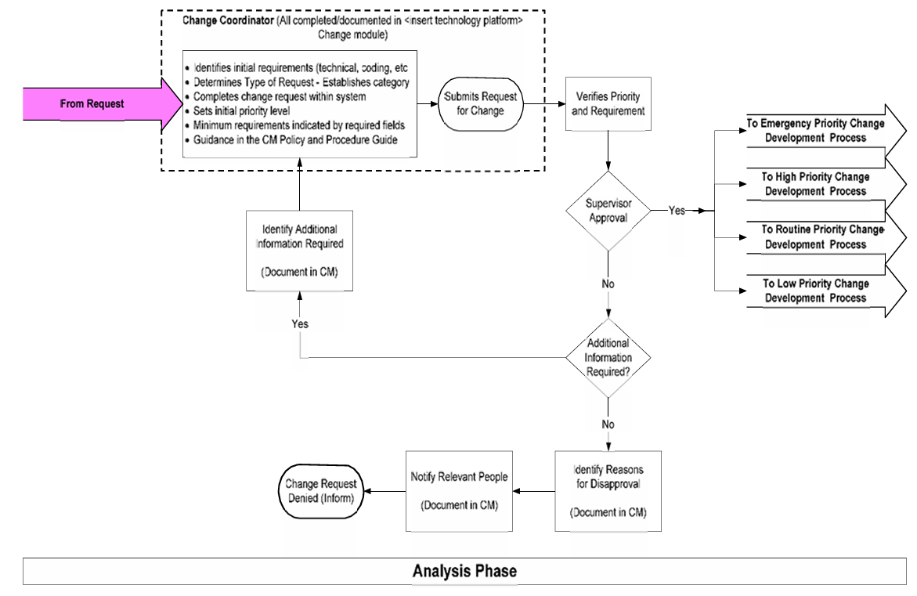

Slide 3
Change Request Lead Time
Priority | Risk Level | Initiation Lead Time (days) | Approval Lead Time (days)
Emergency | High | 3 | 3
 | Moderate | 2 | 2
 | Low | 1 | -
 | No Risk | 1 | 1
Urgent | High | 6 | 3
 | Moderate | 4 | 2
 | Low | 2 | 1
 | No Risk | 1 | 1
Routine | High | 20 | 10
 | Moderate | 15 | 7
 | Low | 10 | 5
 | No Risk | 5 | 3
Low | High | 25 | 15
 | Moderate | 20 | 10
 | Low | 15 | 10
 | No Risk | 7 | 5

Slide 4
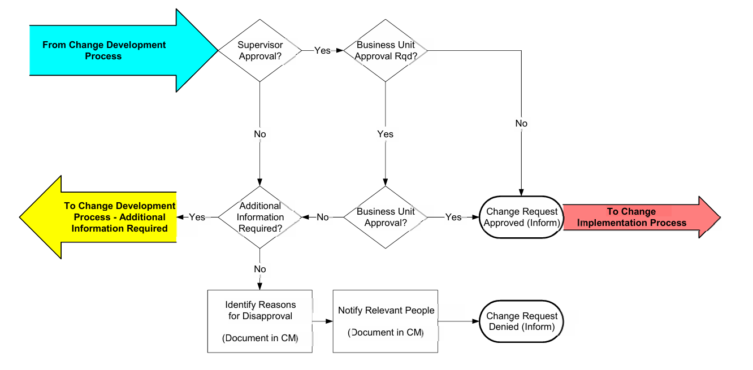
Change Management Flow

Slide 5
Censys
Assessing attack surface for devices connected to internet

Slide 6
Hunter
Search for email addresses belong to website

Slide 7
Fofa
Search for threat intelligence

Slide 8
Zoomeye
Gather information about targets

Slide 9
LeakIX
Search for publicly indexed information

Slide 10
IntelligenceX
Search for Tor, I2P, data leaks, domains and emails

Slide 11
Netlas
Search and monitor internet connected devices

Slide 12
UrlScan
Free service to scan and analyse website.

Slide 13
Publicwww
Marketing and affiliate marketing research

Slide 14
FullHunt
Search and discover attack surface.

Slide 15
CRTsh
Search for certs that have been logged by CT.

Slide 16
LeakIX
Search for publicly indexed information

Slide 17
LeakIX
Search for publicly indexed information

Slide 18
LeakIX
Search for publicly indexed information

Slide 19
LeakIX
Search for publicly indexed information

